Slide 1
IP Addressing and Subnetting
Presentation slides for the course
CSE 323 – Computer Networks
by Mohammad Mamun Elahi
Assistant Professor
Department of Computer Science and Engineering
United International University
mmelahi@uiu.ac.bd

Slide 2
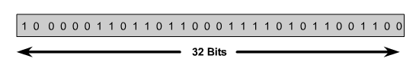

IP Addressing
An IP address is a 32-bit sequence of 1s and 0s.
To make the IP address easier to use, the address is usually written as four decimal numbers separated by periods (dotted decimal format).

Slide 3

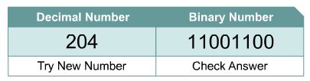
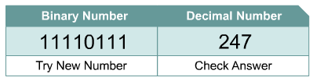
Decimal and Binary Conversion

Slide 4
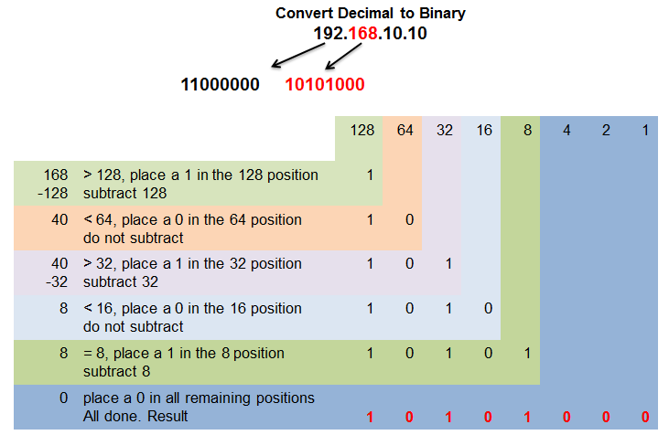
Converting Decimal to Binary
Notes:
Section 8.1.1.5

Slide 5
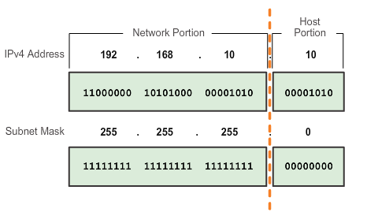
Two Parts: Network and Host
To define the network and host portions of an address, a devices use a separate 32-bit pattern called a subnet mask
The subnet mask does not actually contain the network or host portion of an IPv4 address, it just says where to look for network Part in a given IPv4 address
Notes:
Section 8.1.2.1

Slide 6
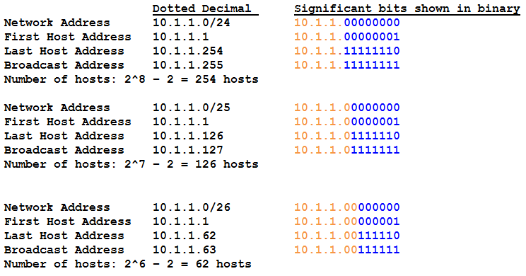
Examining Prefix (Slash Notation)
Notes:
Section 8.1.2.2

Slide 7
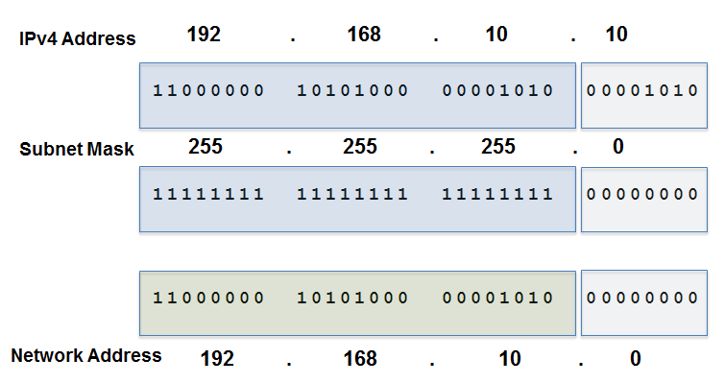
Bit-wise AND Operation
1 AND 1 = 1 1 AND 0 = 0 0 AND 1 = 0 0 AND 0 = 0
Notes:
Section 8.1.2.5 and 8.1.2.6

Slide 8
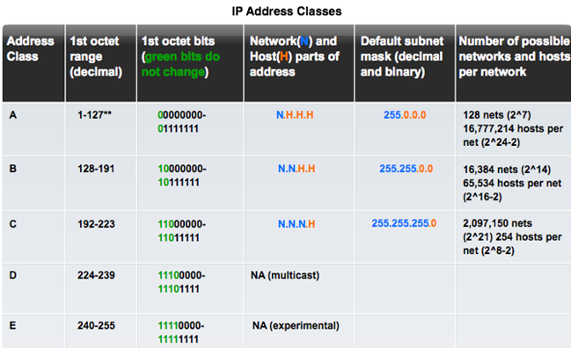

IP V4 Addressing

Slide 9
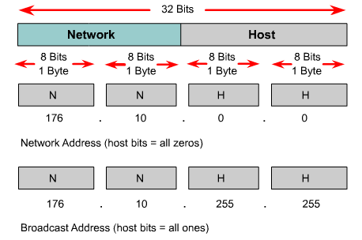
Reserved IP Addresses
Certain host addresses are reserved and cannot be assigned to devices on a network.
An IP address that has binary 0s in all host bit positions is reserved for the network address.
An IP address that has binary 1s in all host bit positions is reserved for the broadcast address.

Slide 10
Network Address

Slide 11
Broadcast Address

Slide 12
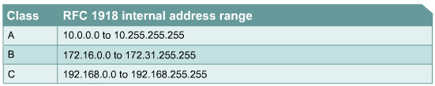
Public and Private IP Addresses
No two machines that connect to a public network can have the same IP address because public IP addresses are global and standardized.
Assigned by the Internet Assigned Numbers Authority (IANA).
Private networks that are not connected to the Internet may use any host addresses, as long as each host within the private network is unique.
Connecting a network using private addresses to the Internet requires translation of the private addresses to public addresses using Network Address Translation (NAT).

Slide 13
Public and Private IP Addresses (contd.)
Private IP addresses can be intermixed with public IP addresses. This will conserve the number of addresses used for internal connections.

Slide 14

Introduction to Subnetting
To create a subnet address, a network administrator borrows bits from the host field and designates them as the subnet field.
IP Address

Slide 15
Reasons for Subnetting
Large networks need to be segmented into smaller sub-networks, creating smaller groups of devices and services in order to:
Control traffic by containing broadcast traffic within subnetwork
Reduce overall network traffic and improve network performance
Subnetting - process of segmenting a network into multiple smaller network spaces called subnetworks or Subnets.
Communication Between Subnets
A router is necessary for devices on different networks and subnets to communicate.
Each router interface must have an IPv4 host address that belongs to the network or subnet that the router interface is connected to.
Devices on a network and subnet use the router interface attached to their LAN as their default gateway.
Notes:
9.1 Subnetting an IPv4 Network
9.1.1 Network Segmentation
9.1.1.1 Reasons for Subnetting
9.1.1.2 Communication Between Subnets

Slide 16
Magic Numbers
MAGIC NUMBERS:
128 64 32 16 8 4 2 1
2⁷ 2⁶ 2⁵ 2⁴ 2³ 2² 2¹ 2⁰
SUBNET MASK:
128 192 224 240 248 252 254 255

Slide 17
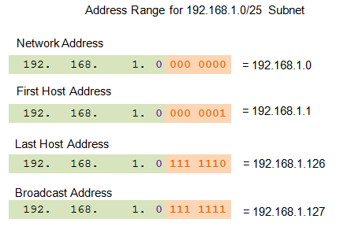
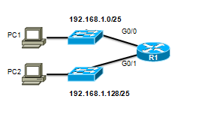

Subnets in Use
Subnet 0
Network 192.168.1.0-127/25
Subnet 1
Network 192.168.1.128-255/25
Notes:
9.1.3.2 Subnets in Use

Slide 18
Subnetting based on Host Requirements
There are two considerations when planning subnets:
Number of Subnets required
Number of Host addresses required
Formula to determine number of useable hosts
2^n-2
2^n (where n is the number the number of host bits remaining) is used to calculate the number of hosts
-2 Subnetwork ID and broadcast address cannot be used on each subnet
Notes:
9.1.4 Determining the Subnet Mask
9.1.4.1 Subnetting based on Host Requirements

Slide 19
Magic Formulas
Number of Usable Subnets
2^{n}
2⁰ = 1
2¹ = 2
2² = 4
2³ = 8
Number of Usable Hosts/Subnet
2^{h-n} – 2
2⁸⁻⁰- 2 = 256 - 2 = 254
2⁸⁻¹- 2 = 128 - 2 = 126
2⁸⁻²- 2 = 64 - 2 = 62
2⁸⁻³- 2 = 32 - 2 = 30
n = # borrowed bits
h = # bits available in host address

Slide 20
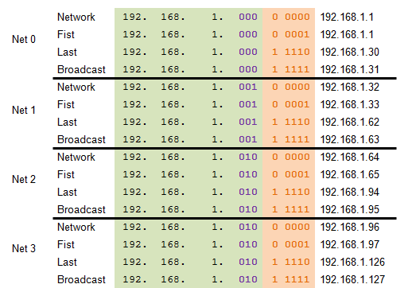
Example: Creating 8 Subnets
Borrowing 3 bits to Create 8 Subnets. 2³ = 8 subnets
Notes:
9.1.3.5 Creating 8 subnets

Slide 21
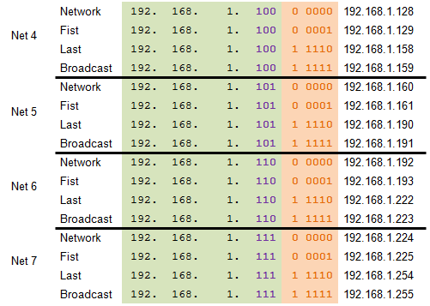
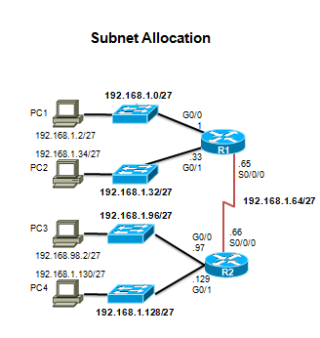
Example: Creating 8 Subnets ( contd. )
Notes:
9.1.3.5 Creating 8 Subnets (continued)

Slide 22
Set Up Subnets
200.200.200.10
What is the Subnet Mask?
What are the Network Addresses?
What is the Broadcast Domain
What IP Addresses are available?
5 Subnets

Slide 23
Example – 1
128.16.32.13
What is the Subnet Mask?
What are the Network Addresses?
What is the Broadcast Domain
What IP Addresses are available?
* Needs 500 Subnets

Slide 24
Example – 2
175.116.23.13/21
What is the Subnet Mask?
What are the Network Addresses?
What is the Broadcast Domain
What IP Addresses are available?
Subnet:
At least 500 host/subnet
175.116.200.15?
?
?
?
?

Slide 25
Questions????

